Slide 1
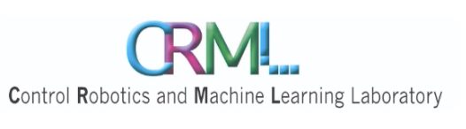


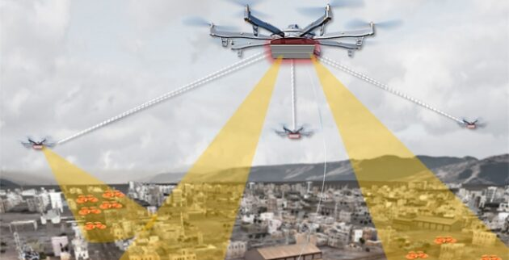
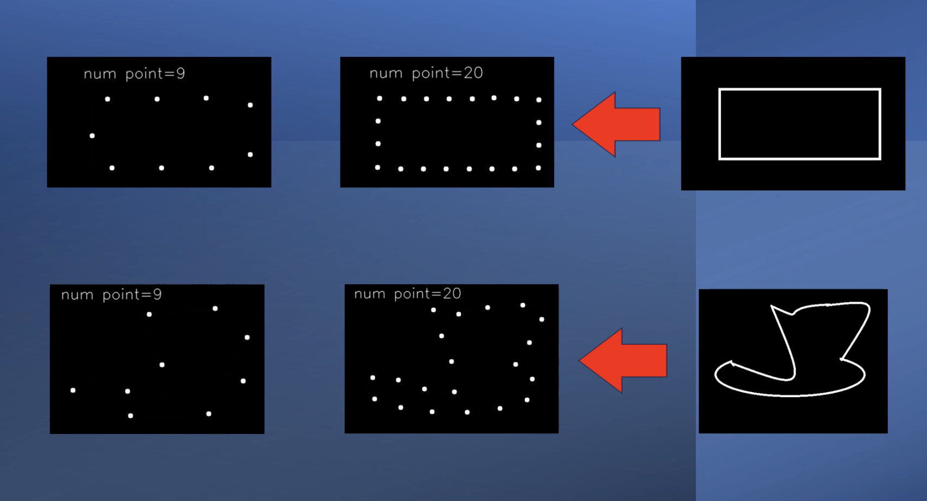
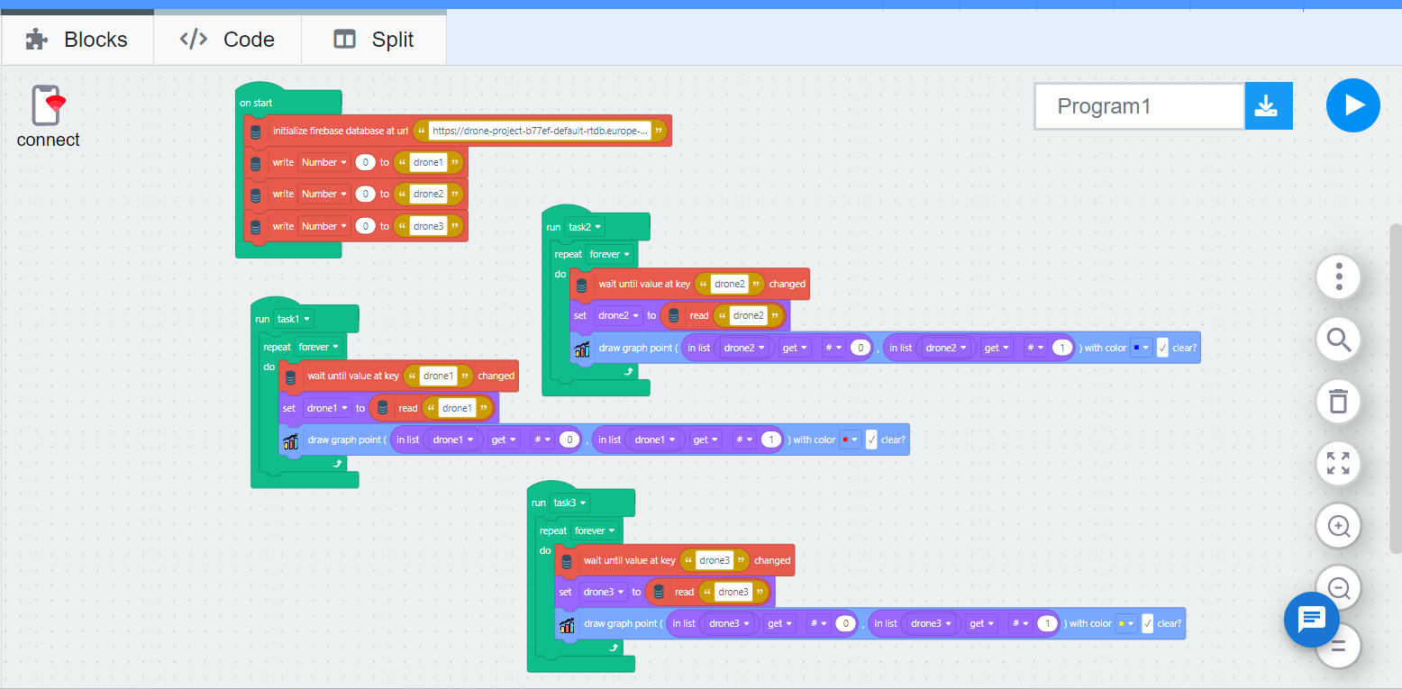
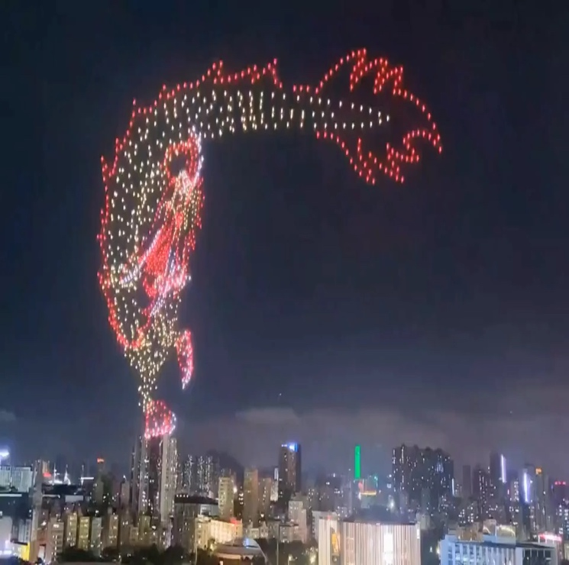
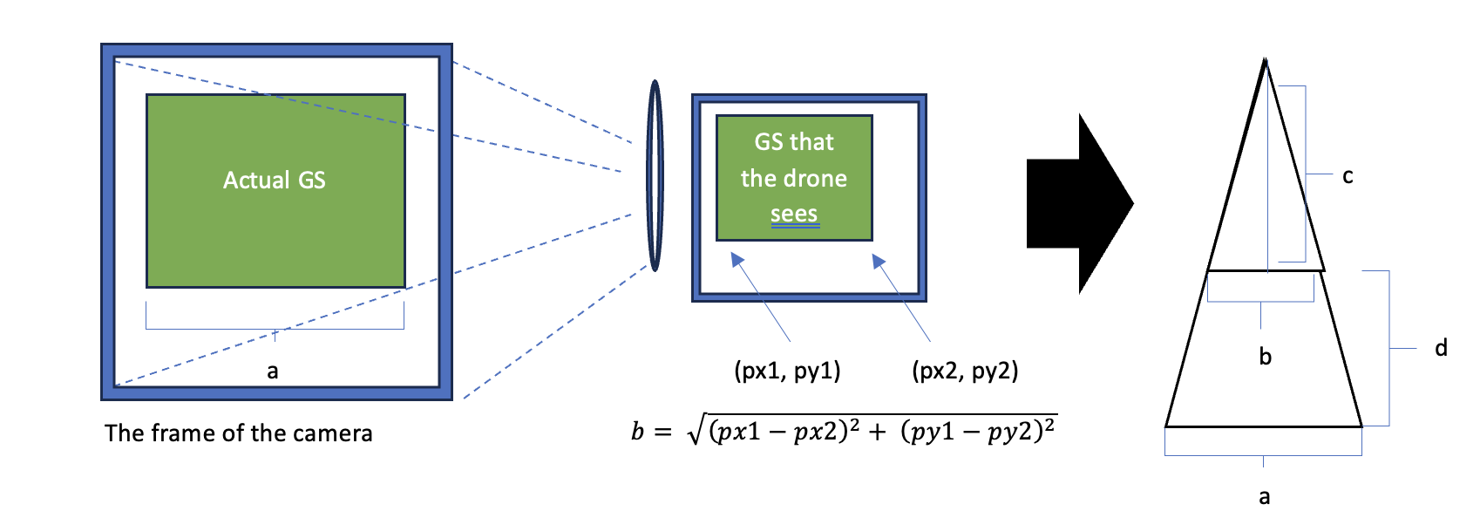
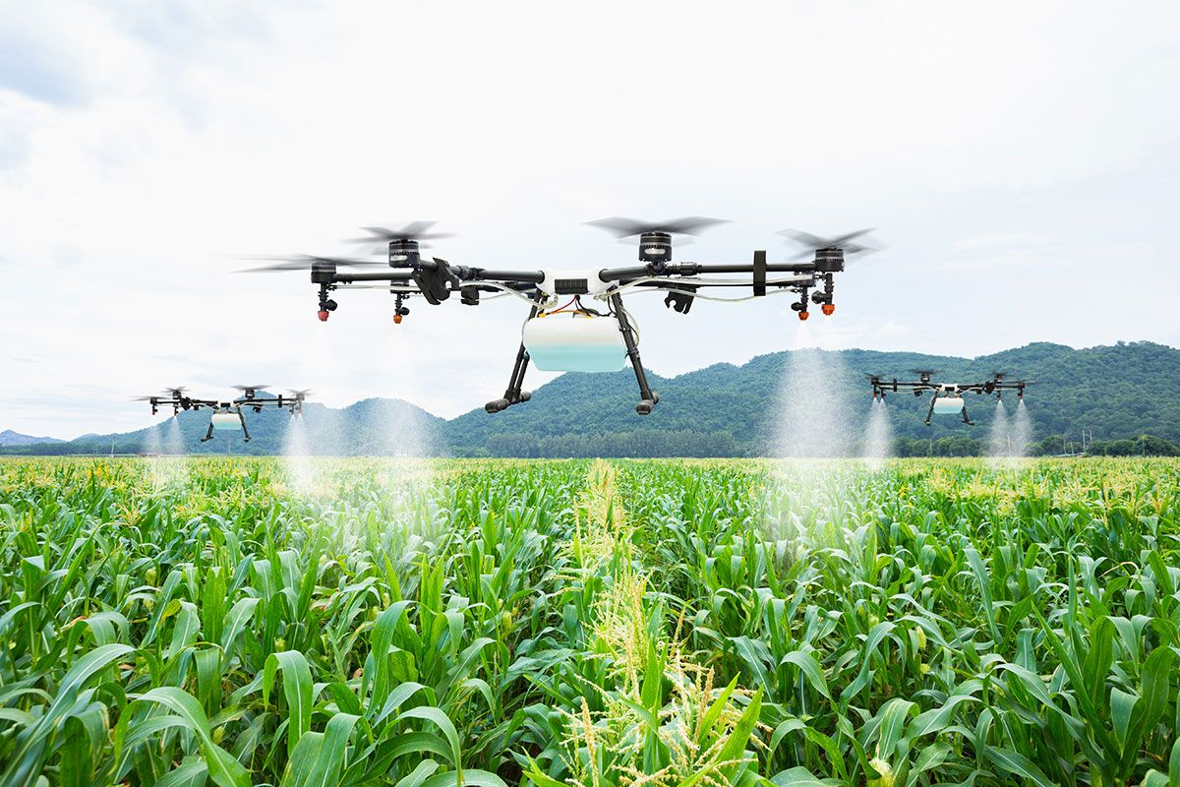
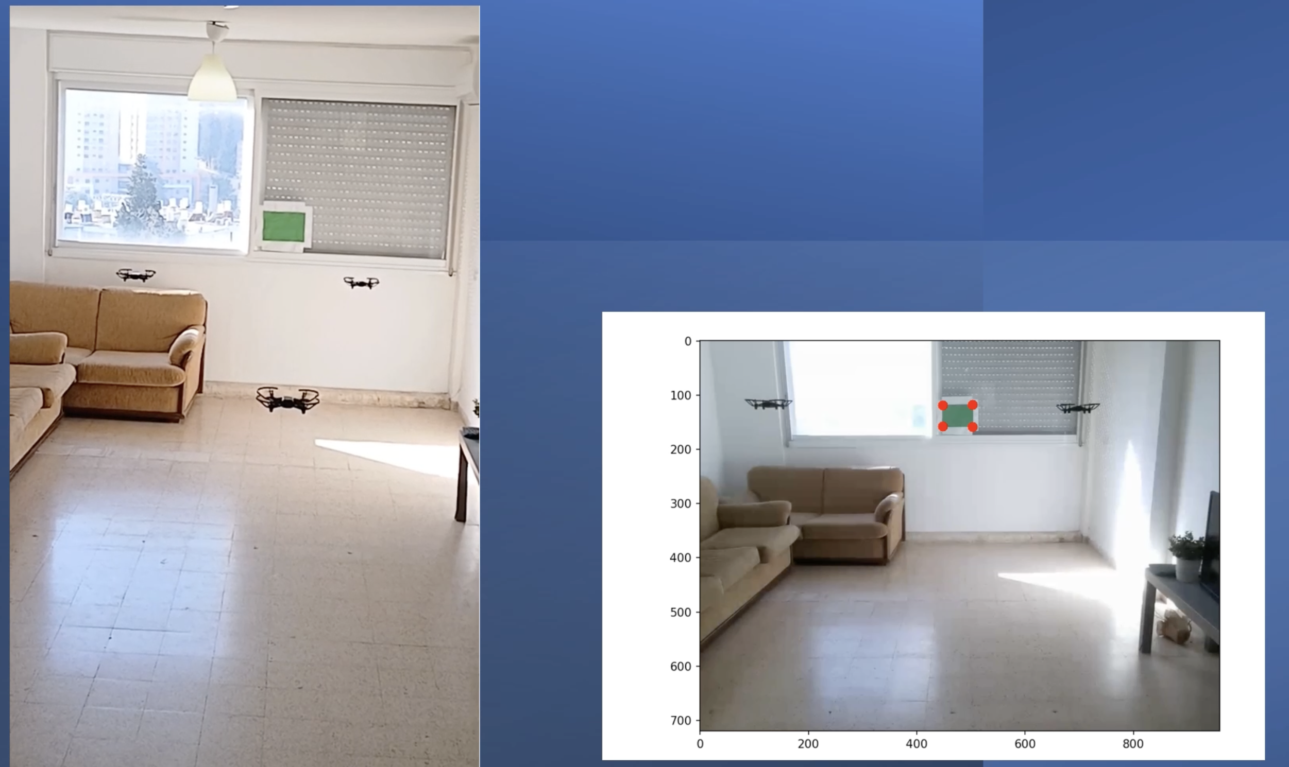
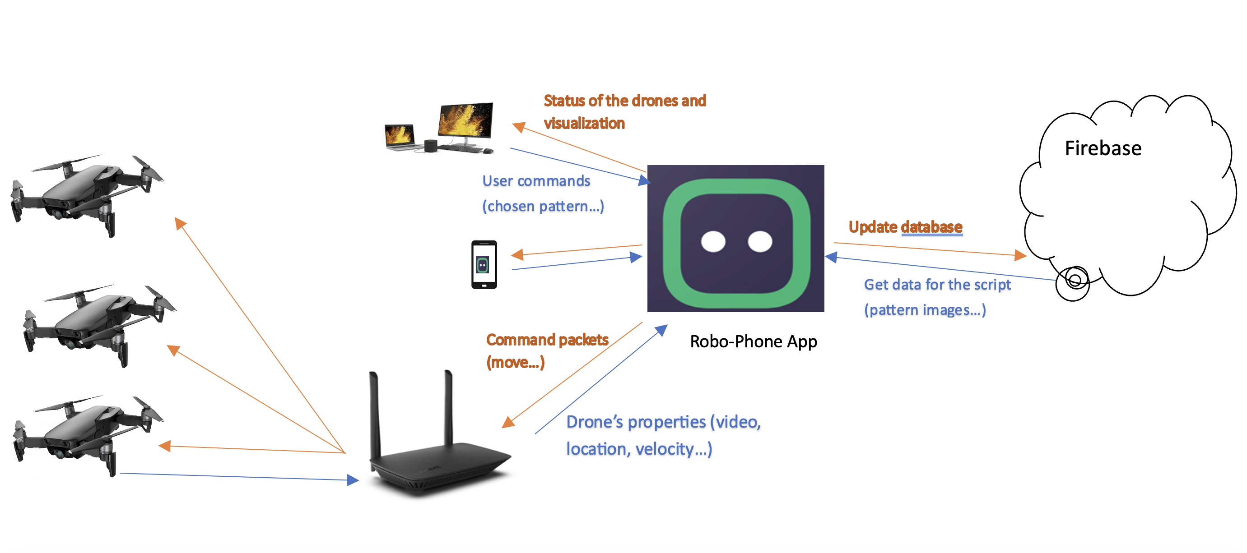
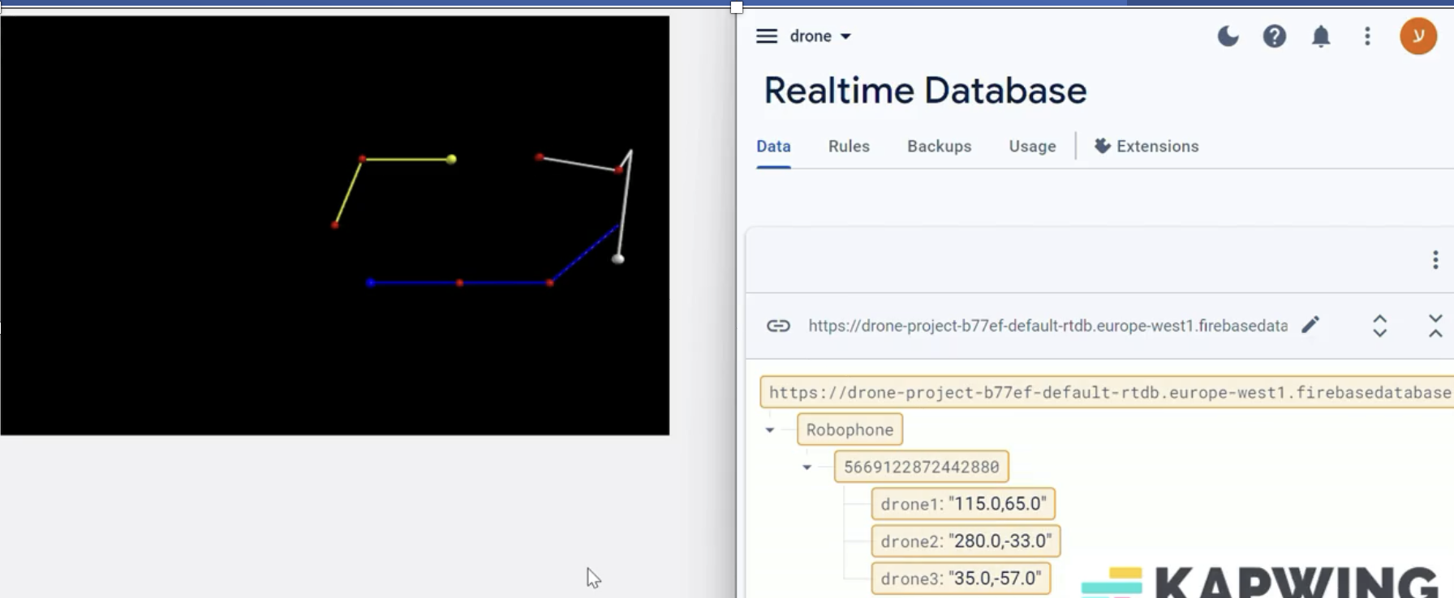
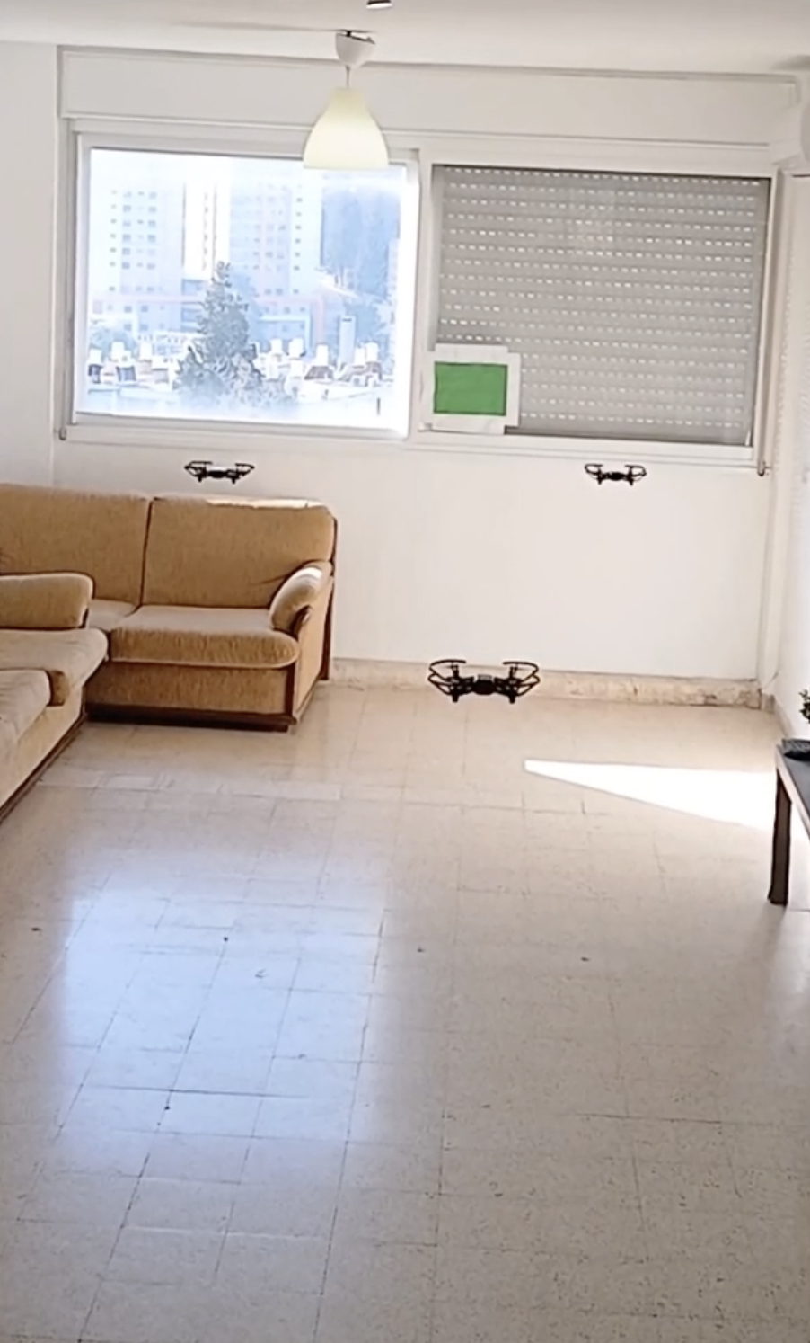
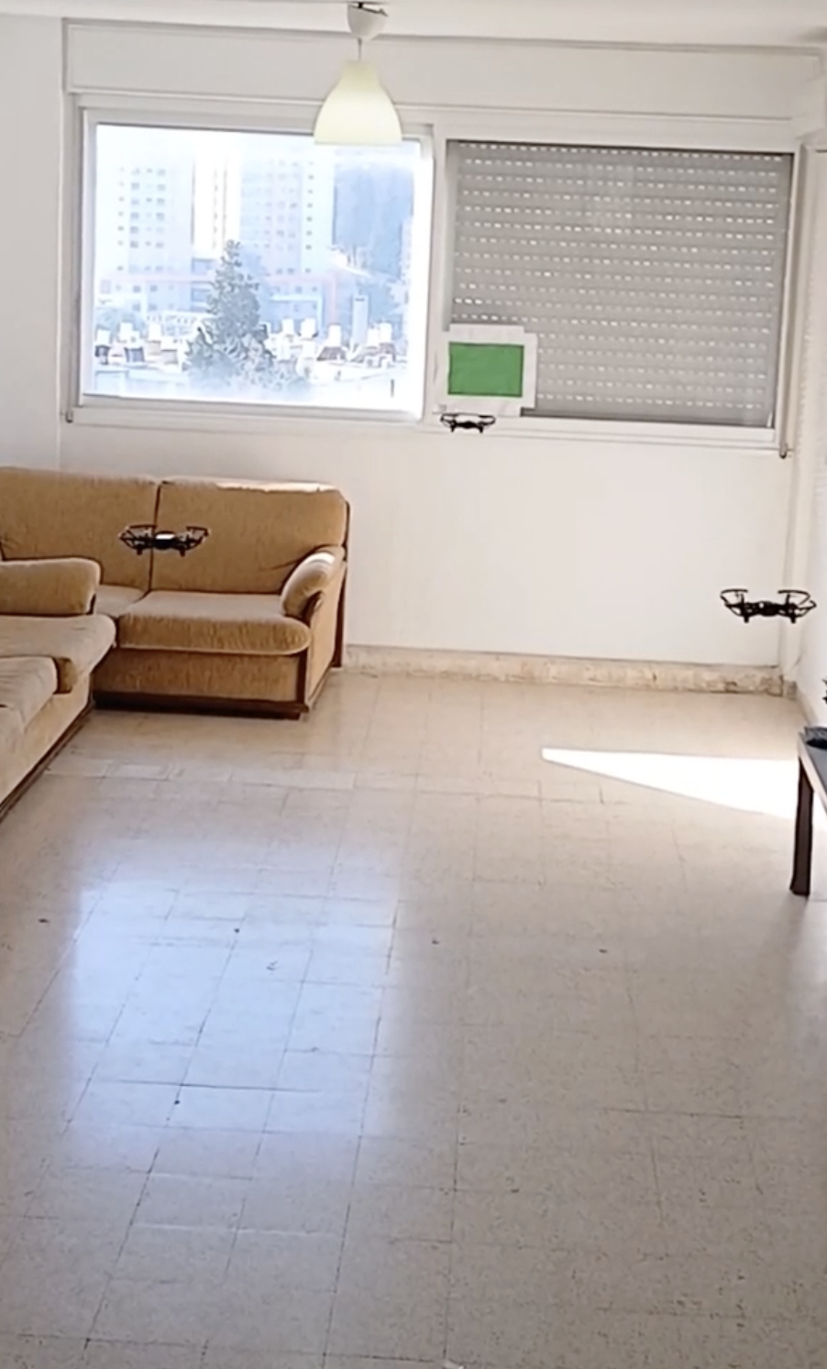
Andrew and Erna Viterbi
Faculty of Electrical Engineering
Swarm of Drones Choreography
Formation and Shape Control
Oz Arye & Arnold Cheskis, Supervised by Ofer Danino
Introduction
Robo-phone.com
The process
The ability to control a swarm of drones, while complicated in its nature, has a variety of significant uses.
Military and security; scan large areas
Provides an interface and built-in tools and libraries to control robots
User-friendly interface without any need to write a single line of code.
Provides you with clear visualizations of the program’s flow using the colored blocks and information on the current status through the app.
Compatible with Firebase, through which it provides integration with the cloud.
The user begins by either selecting an image of the flight pattern from the existing database or by uploading a new one to the Robo-phone interface. Next, the user gives the start command and the interface sends the image from the server to the computer via Firebase.
Next, the computer analyzes the image and converts the shape into coordinates.
Entertainment; drone shows
Path correction
Occasionally, due to their instability, the drones will stray from the desired movement pattern. To correct it we used their cameras and an external cue, in the form of a green square, to infer their real-time location and calculate where they should move next to get on the right track.
System overview
Agriculture; automation of movements saves resources when controlling large
The stations, i.e. the drones, communicate with the central command, i.e. the computer, through the router using Wi-Fi in access point mode.
The user selects or uploads an image of the flight pattern to the cloud using the Robo-phone interface.
The computer receives data, such as images, from the drones and the server.
The image from the server is used as a template for the correct movement pattern.
The computer creates class Drone() to update and control each of the drones’ attributes, e.g. velocity, location, etc.
Path Simulation and Firebase
Goal
Using VPython the user can simulate the drones’ movement or get a real-time visualization of their movement pattern on the cloud, i.e. Firebase.
From the visualization, we can conclude whether the correction of their movement pattern takes place.
Create a powerful tool to control a complicated movement of drone swarms
User signs up & downloads robo-phone.com
User uploads the image of the drones’ movement pattern
The server sends the image to the computer that converts it to coordinates
The computer commands and corrects the drones’ movements
Challenges
Drones’ instability, especially with cheaper ones used outdoors where external forces have great significance.
The bandwidth of the WIFI channels limits the amount of feedback the computer can get, in the form of images, from the drones. This in turn affects the speed of the pattern correction.
Delayed communication with the cloud prevents us from running the algorithms on the server and saving space on the PC.
February 2024

